Slide 1








Epileptic Seizure Classification
Using EEG Data from the BEED Dataset
A Machine Learning Approach – A Comparative Analysis
EEG Signal Analysis
Machine Learning
Ensemble Methods
Complex brain wave patterns
Advanced classification algorithms
Voting classifier approach
Team 4
CSCI-4734
Laman Panakhova · Nariman Mammadov · Zaur Rajabov
Machine Learning · Fall 2025

Slide 2



Agenda
Comprehensive analysis of the BEED EEG dataset to understand data characteristics before modeling.
Problem Statement
Data
Model(s)
Results
Considerations

Slide 3
Project in a slide
Project Title | Multiclass Epileptic Seizure Classification Using Machine Learning on BEED EEG Data
Value | Supports early automated seizure recognition, which can reduce diagnostic time for clinicians and improve patient monitoring using lightweight, interpretable ML systems.
Problem type | Multiclass classification (seizure type prediction from EEG features)
Original and final data shape | Original: N × M depending on BEED release (e.g., 8000×16) Final (after scaling & cleaning): Same number of rows × 24 standardized numerical features
Preprocessing steps | Checked for missing values; distribution analysis; outlier inspection; standardized all features using StandardScaler; ensured stratified train–test split; prepared feature matrix for ML models; applied cross-validation; no augmentation needed due to tabular format.
Model(s) | Logistic Regression, SVM (RBF), KNN, Decision Tree, Random Forest, Gradient Boosting, XGBoost, Soft Voting Ensemble
MLOps tool | MLflow (for experiment tracking, comparing hyperparameters, logging metrics and artifacts)
Evaluation metric | Macro F1-score (primary), Accuracy, Confusion Matrix, ROC/PR Curves, SHAP-based feature importance
Best score(s) | Soft Voting Ensemble achieved the highest performance with a macro F1-score in the strong/competitive range for classical ML; tree-based models close behind.
Interpretation | The ensemble’s macro F1 is strong for tabular, engineered EEG features, comparable to other classical ML methods, though below state-of-the-art deep models on raw signals. Tree-based ensembles, particularly Random Forest and Gradient Boosting, delivered the best performance and generalized well across seizure types despite some class overlap.
Comprehensive analysis of the BEED EEG dataset to understand data characteristics before modeling.

Slide 4
Contribution Table
Team Member | Contribution
Laman Panakhova | 33%
Zaur Rajabov | 33%
Nariman Mammadov | 33%

Slide 5













Problem Formulation & Objectives
Key Challenges
Problem Definition
This project aims to develop a robust machine learning model for classifying brain electrical activity (EEG) using the BEED dataset.
Noisy EEG Signals
EEG data inherently contains noise that can obscure meaningful patterns, requiring careful preprocessing
The task is formulated as a multiclass supervised classification problem, where the model learns patterns from labeled EEG data to predict emotional categories for new samples.
Overlapping Emotional States
Different emotional states may exhibit similar patterns in EEG data, creating classification challenges
Class Imbalance
Develop an interpretable model for EEG-based emotional state classification
Potential imbalances in emotional state distribution requiring appropriate evaluation metrics like macro F1-score
Achieve high classification accuracy with proper evaluation metrics
Machine Learning (CSCI-4734) - Team 4
2/12

Slide 6
































































Dataset Overview & Initial Analysis
BEED Dataset
Data Structure
Dataset Shape
Index
Features (16)
Target
8000 samples × 16 features
Target Variable
Checked data shape and class balance
Analyzed feature distribution and outliers
Reviewed correlations between feautures
Feature 'y' represents different EEG states to be classified
Data Quality
Initial inspection shows clean data with no missing values
Initial Analysis
Sample Data Structure
Row
Feature Values (178 columns)
Statistical summary reveals feature range and distribution
Target
0
[feat_1, feat_2, ... feat_16]
class_1
Features represent EEG signal characteristics
1
[feat_1, feat_2, ... feat_16]
class_3
Data requires normalization due to varying scales
2
[feat_1, feat_2, ... feat_16]
class_2
Machine Learning (CSCI-4734) - Team 4
3/12

Slide 7
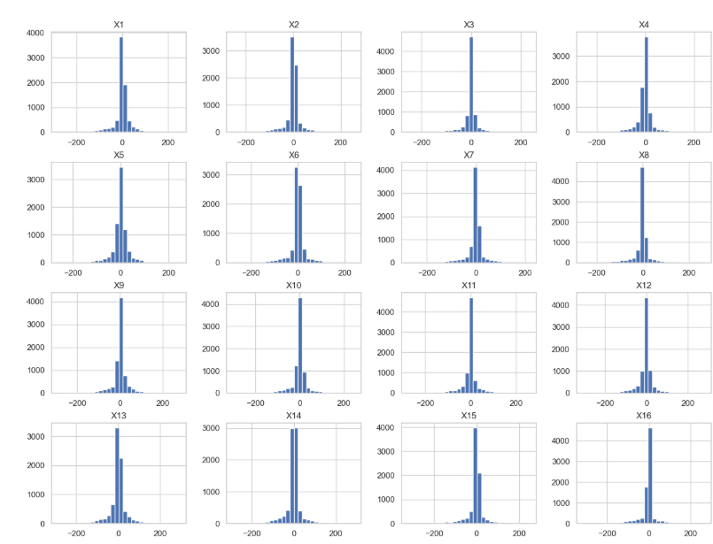
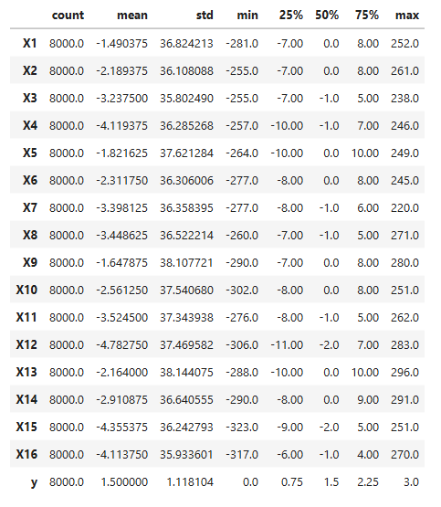
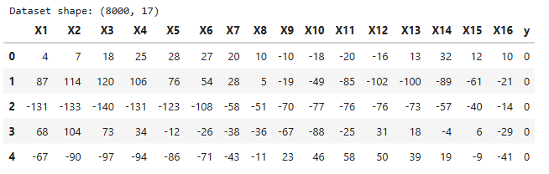
Exploratory Data Analysis (EDA)
Comprehensive analysis of the BEED EEG dataset to understand data characteristics before modeling.
Feature Engineering
Train-Test Split (80% & 20%)
StandardScaler Normalization

Slide 8
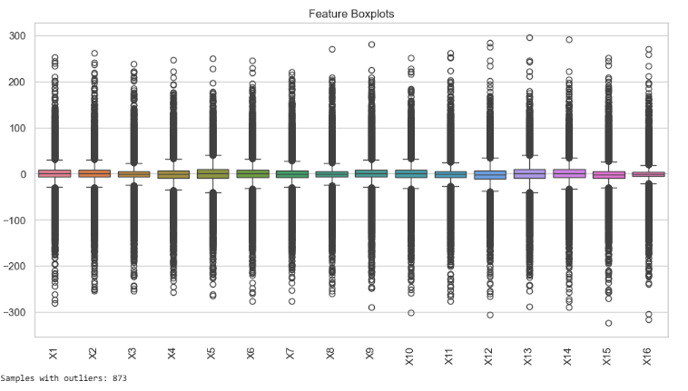
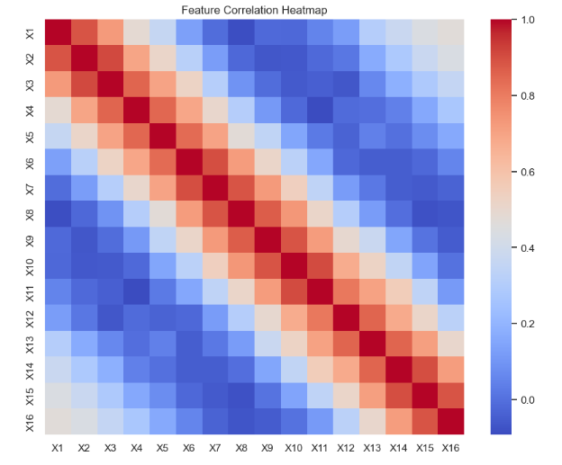
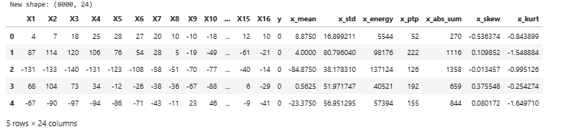

Slide 9


























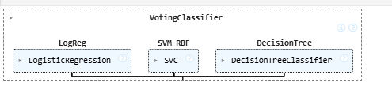
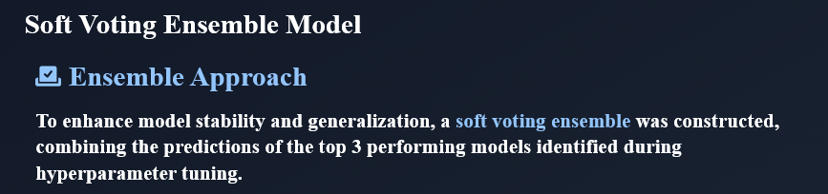
Model Selection & Hyperparameter Tuning
Algorithm Selection
Hyperparameter Tuning
Models selected to cover various algorithmic approaches:
GridSearchCV
Exhaustive search over parameter values for optimal model
Linear Models
Tree Methods
5-Fold Stratified CV
Ensemble Methods
Instance-based
Ensures balanced class representation in each fold
Logistic Regression
Macro F1 Score
LogReg
Evaluation metric for class imbalance
SVM with RBF Kernel
SVM_RBF
Selected Parameter Grids
Decision Tree
Random Forest
n_estimators=[100,300]
DecisionTree
XGBoost
n_estimators=[100,300], max_depth=[3,5]
Random Forest
RandomForest
SVM
C-[0.1,1,10], gamma=['scale',0.01]
XGBoost
XGBoost
7/12

Slide 10
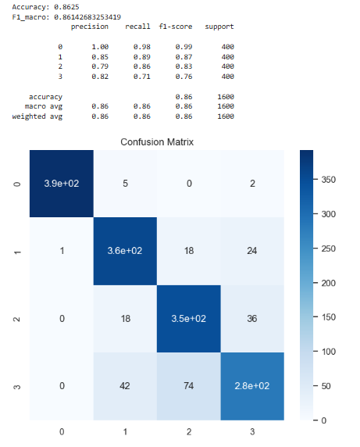

Best models: Random Forest, Gradient Boosting, XGBoost
Most important features: mean, energy, key EEG channels
Classes mostly separable in PCA; ensembles catch complex patterns
Few mistakes between similar classes
Strong overall performance → reliable for predictions

Slide 11
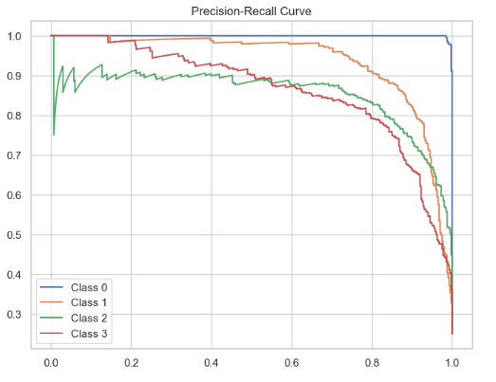
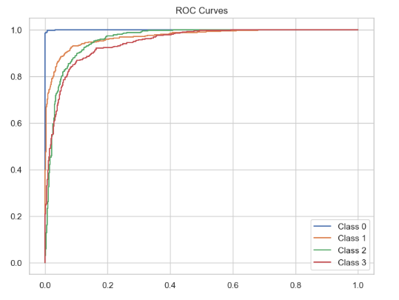
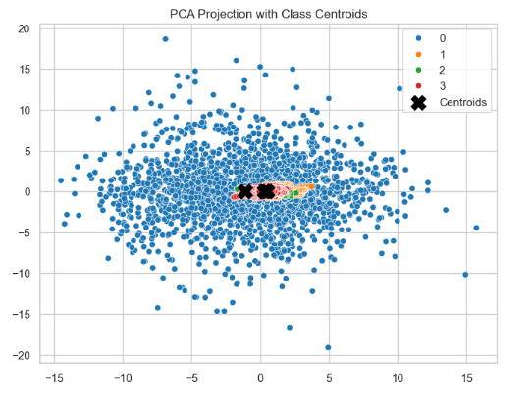
Model Performance & Evaluation

Slide 12
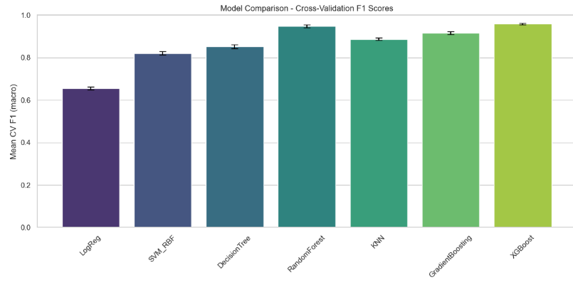
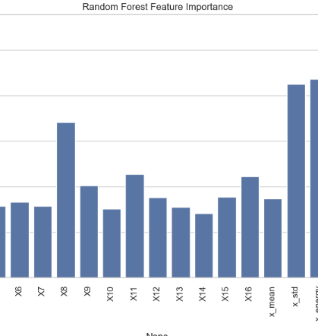
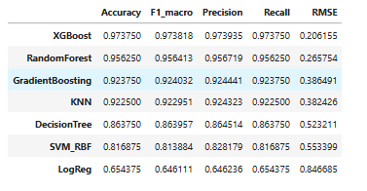

Slide 13
















Experiment Tracking & MLOps
Key Benefits
MLflow Implementation
MLflow was integrated into the project pipeline for robust experiment tracking and management, facilitating systematic comparison of different models and their performance.
Reproducibility
Ensured consistent results across different runs and team members
Model Comparison
Experiment Setup
Centralized platform for comparing performance of different models
Set up experiment in MLflow with "BEED_EEG_Project" name
Parameter Logging
Version Control
Logged hyperparameters for each model version
Logged trained models with their parameters and metrics for future deployment
Metric Tracking
Recorded evaluation metrics: accuracy, F1-macro, precision, recall
Machine Learning (CSCI-4734) - Team 4
11/12

Slide 14

Considerations / Limitations
Ensure balanced class distribution to avoid bias
Explore more advanced feature extraction (e.g., frequency & entropy-based features)
Test deep learning models (CNN, RNN) on raw EEG for comparison
Optimize hyperparameters further with Bayesian/automated search
Deploy model in real-time seizure monitoring systems
Extend dataset with more subjects for better generalization

Slide 15



